Slide 1


TITLE OF THE PROJECT RF-BASED GEO LOCATION GUIDE
Sreyas Institute of Engineering and Technology
An Autonomous Institution
Approved by AICTE, Affiliated to JNTUH
Accredited by NAAC-A Grade, NBA (CSE, ECE & ME) & ISO 9001:2015 Certified
DEPARTMENT OF ELECTRONICS & COMMUNICATION ENGINEERING
Presented by [A-9]
M.SHRAVYA (23VE5A0404)
SHAIK ALISHA (22VE1A0455)
B.VENKATESH (22VE1A0406)

Slide 2
Abstract RF - BASED GEO LOCATION GUIDE
The RF-based Geo Location Guide is a smart navigation system designed for indoor
or localized areas such as campuses, museums, exhibition halls, or industrial sites. It
uses Radio Frequency (RF) technologies like RFID or Bluetooth to determine a user's
position. RF transmitters placed at key locations communicate with a receiver carried
by the user. Based on signal strength and tag identification, the system estimates the
user’s current location and provides real-time directions or relevant information.
Unlike GPS, which struggles indoors, this RF-based solution is reliable, cost_x0002_effective, energy-efficient, and scalable. It enhances user experience in complex
environments and is useful for smart navigation, asset tracking, and guided tours. The
project combines hardware integration, signal processing, and user-friendly software,
offering a practical example of location-based services in smart infrastructure.

Slide 3
Tools / Equipment / Components Utilized RF-Based Geo location Guide
Aruduino UNO
RF transmitter & Recevier (433 MHz)
Buzzer
LEDs
Buttons

Slide 4
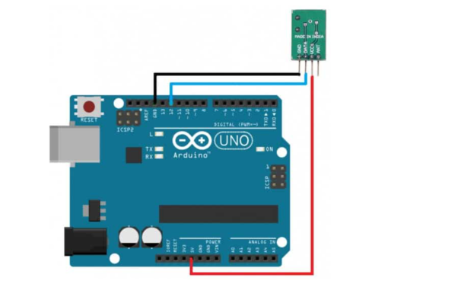
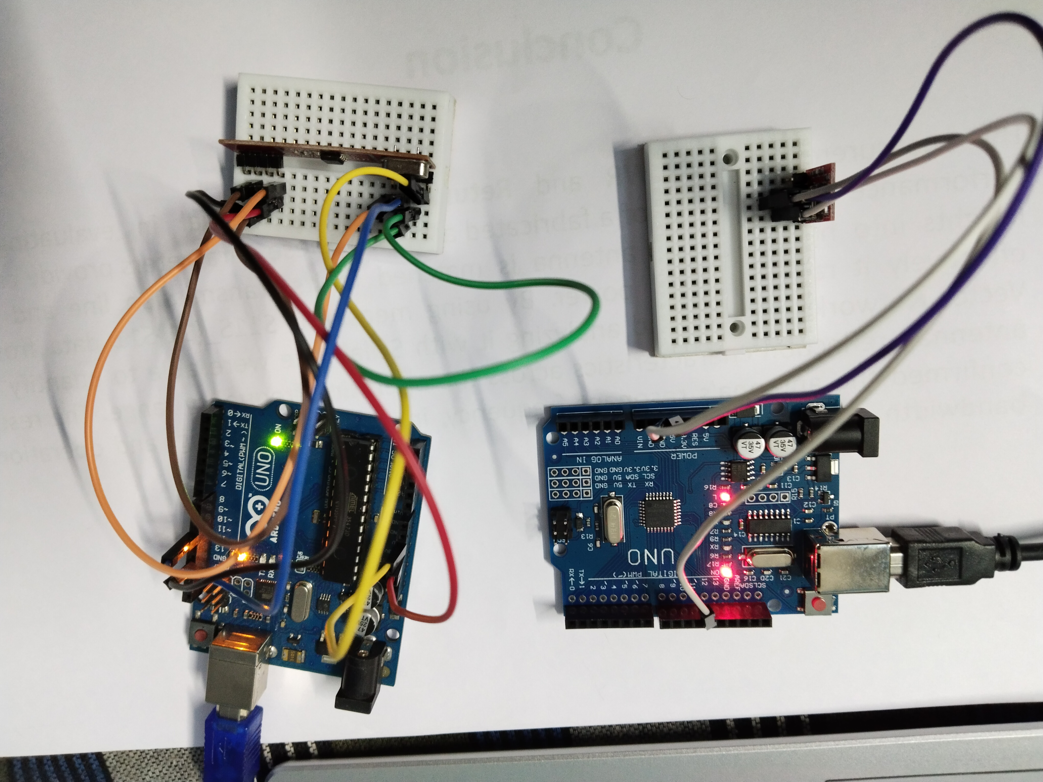
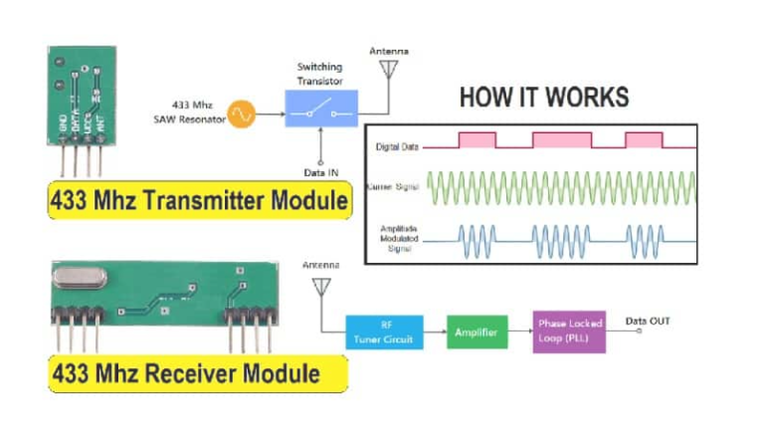
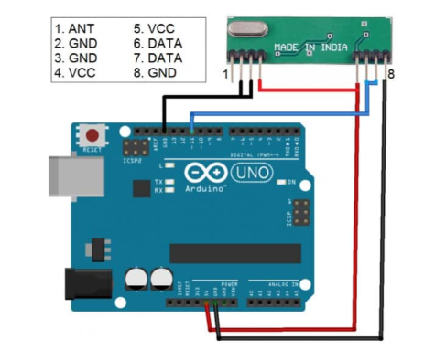
Circuit Diagram

Slide 5
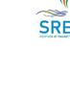
Simulation Results CODE :
#include <RH_ASK.h> // Include RadioHead Amplitude Shift Keying Library
#include <SPI.h> // Include dependant SPI Library
// Create Amplitude Shift Keying Object
RH_ASK rf_driver;
void setup()
{
// Initialize ASK Object
rf_driver.init();
// Setup Serial Monitor
Serial.begin(9600);
}
void loop()
{
const char *msg = "Hello World";
rf_driver.send((uint8_t *)msg, strlen(msg));
rf_driver.waitPacketSent();
{
// Message Transmitted
Serial.println("Message Transmitted: ");
delay(1000); }}

Slide 6
#include <RH_ASK.h> // Include RadioHead Amplitude Shift Keying Library
#include <SPI.h> // Include dependant SPI Library
// Create Amplitude Shift Keying Object
RH_ASK rf_driver;
void setup()
{
// Initialize ASK Object
rf_driver.init();
// Setup Serial Monitor
Serial.begin(9600);
}
void loop()
{
// Set buffer to size of expected message
uint8_t buf[11];
uint8_t buflen = sizeof(buf);
// Check if received packet is correct size
if (rf_driver.recv(buf, &amp;buflen))
{
// Message received with valid che-cksum
Serial.print("Message Received: ");
Serial.println((char*)buf);
}
}

Slide 7
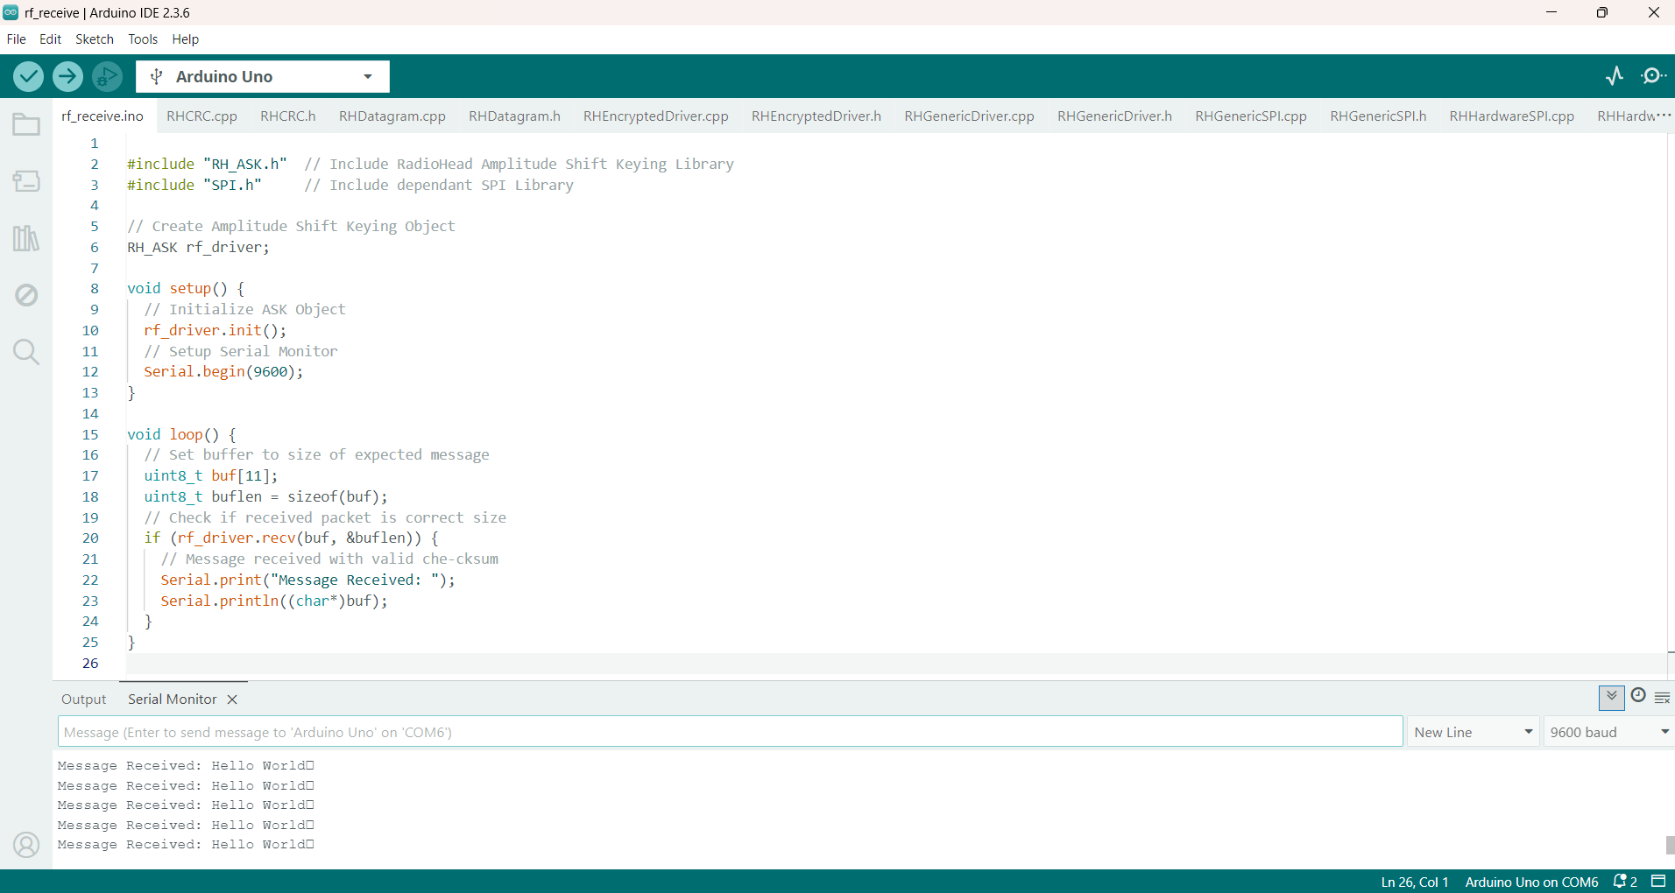
Parameters Evaluated / Derived

Slide 8
Advantages & Applications
Advantages :
Long range capabilities
No GPS Dependence
Precise Tracking
Enhanced Security
Applications :
Military Intelligence
Critical Infrastructure Security

Slide 9
Conclusion & Future Scope
n conclusion, RF-based geolocation guides, using technologies like TDoA, PoA, and AoA, offer a viable solution for tracking and guiding users in various locations, especially where GPS may be unavailable or unreliable. By leveraging radio signals, these systems can provide accurate location information, even in challenging environments, and can be further enhanced with features like text-to-speech or audio alerts

Slide 10
References
BooksT.S. Rappaport, Wireless Communications: Principles and Practice, Pearson Education.Behrouz A. Forouzan, Data Communications and Networking, McGraw-Hill.Datasheets & LibrariesRadioHead ASK Library for Arduino: https://www.airspayce.com/mikem/arduino/RadioHead/433 MHz RF Module Datasheet (e.g., FS1000A Transmitter + XY-MK-5V Receiver)Websites / TutorialsArduino Official Site: https://www.arduino.ccRFID/Bluetooth Geolocation Systems Overview: https://circuitdigest.com

